Slide 1
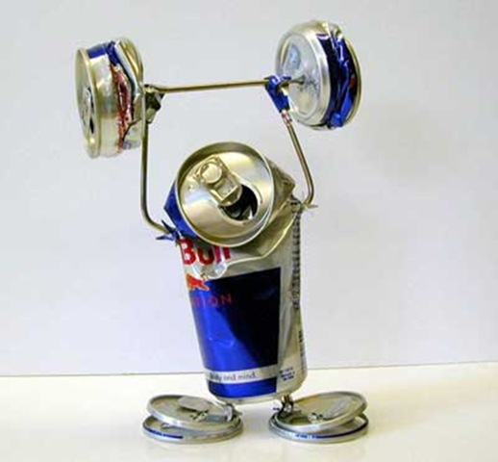
Cutting Electricity Cost For Service Provider Networks
Muhammad Saqib Ilyas
FDC
Zartash Afzal Uzmi
Tariq Mahmood Jadoon
Ihsan Ayyub Qazi
Muhamad Fareed Zaffar
Aamir Qayyum

Slide 2
Agenda
Background and motivation
Opportunity and key idea
Case studies:
Data centers (e.g., Facebook and Google)
Cellular networks (e.g., Sprint and Verizon)
Conclusions and future work

Slide 3

Background
Source: freeimages.com

Slide 4
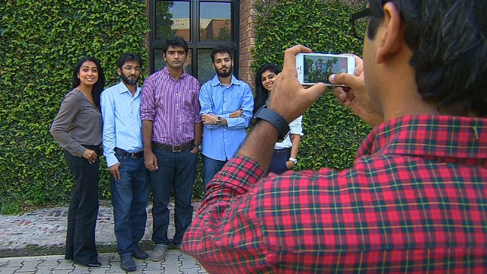
Background
Source: freeimages.com

Slide 5

Background
The Internet

Slide 6
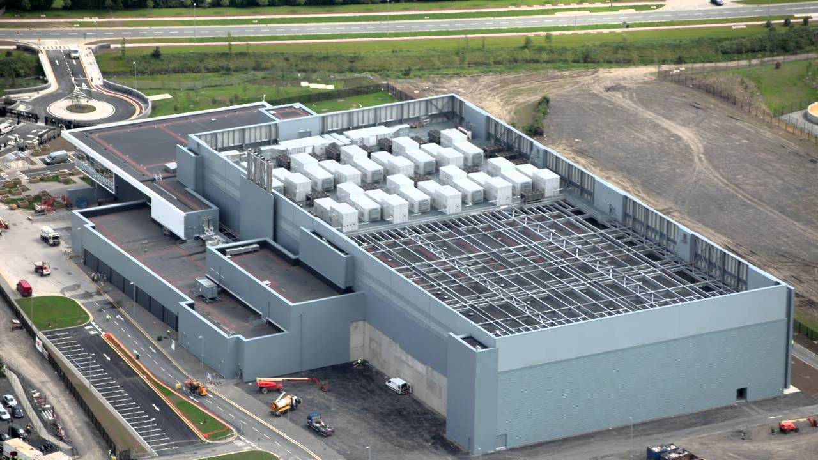
Background
A data center
The Internet
Source: youtube.com

Slide 7
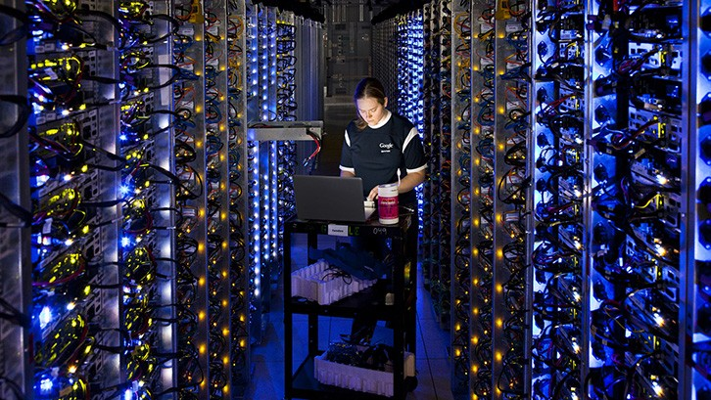
Background
The Internet
Source: cnet.com

Slide 8
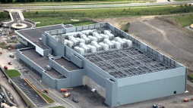
Background
The Internet

Slide 9

Background
The Internet

Slide 10


Background
The Internet
Source: flaticon.com

Slide 11
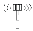
Background
The Internet
Source: vcetsiras.blogspot.com

Slide 12
Background
The Internet

Slide 13
Background
The Internet

Slide 14
Background
Federated networks empower communication
The Internet

Slide 15
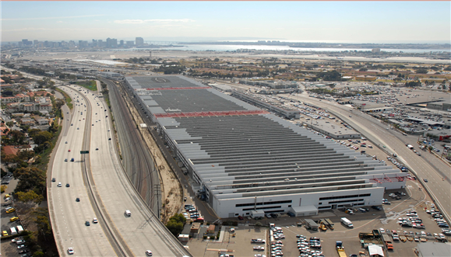
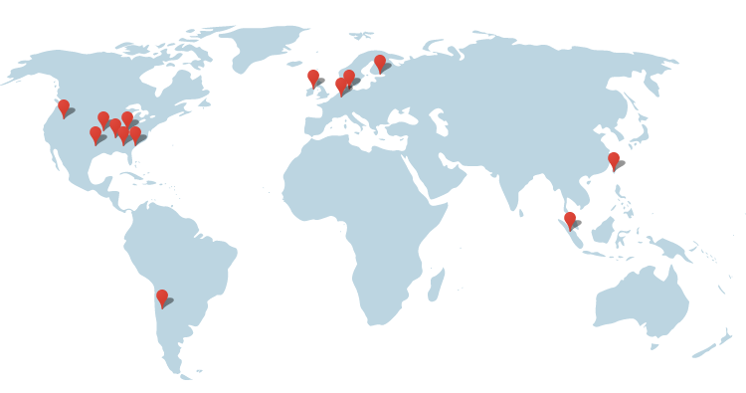
Network Scale
1 Data Center ~ 50,000 - 80,000 servers
Parameter | Microsoft | Amazon | Google
Servers | Millions | 2.8 – 5.6 M | 900000
Data Centers | > 26 | ~ 87 | 14
Image source: http://bit.ly/1awWnLn

Slide 16
Network Scale
1 Data Center ~ 50,000 - 80,000 servers
Parameter | Microsoft | Amazon | Google
Servers | Millions | 2.8 – 5.6 M | 900000
Data Centers | > 26 | ~ 87 | 14
Google’s data center locations
http://bit.ly/1WbIvbe

Slide 17
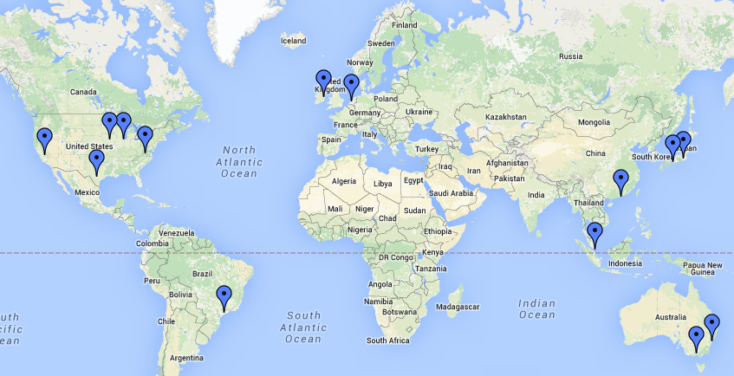
Network Scale
1 Data Center ~ 50,000 - 80,000 servers
Parameter | Microsoft | Amazon | Google
Servers | Millions | 2.8 – 5.6 M | 900000
Data Centers | > 26 | ~ 87 | 14
Microsoft Azure’s data center locations
http://bit.ly/1mqvi26

Slide 18
Network Scale
Parameter | Microsoft | Amazon | Google
Servers | Millions | 2.8 – 5.6 M | 900000
Data Centers | > 26 | ~ 87 | 14

Slide 19
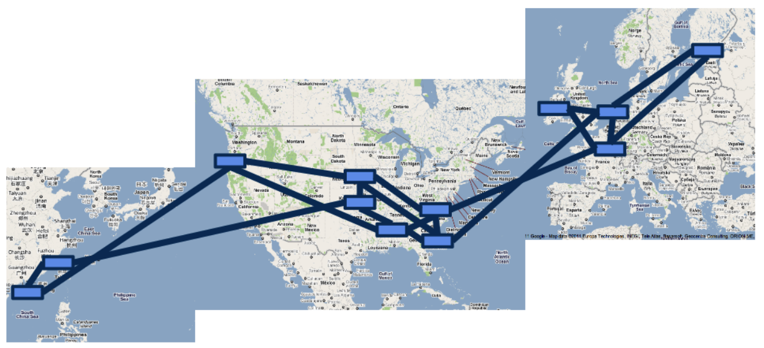
Network Scale
Google’s B4 SDN
Image Source: Jain et. al, “B4: Experience with a globally-deployed software defined WAN”

Slide 20
Network Scale
Data Center
Google’s B4 SDN
Image Source: Jain et. al, “B4: Experience with a globally-deployed software defined WAN”

Slide 21
Network Scale
Inter Data Center Links
Data Center
Google’s B4 SDN
Image Source: Jain et. al, “B4: Experience with a globally-deployed software defined WAN”

Slide 22
Network Scale
Telenor: 8000 cell sites

Slide 23
Network Scale
Massive infrastructure

Slide 24
Network Scale
Massive infrastructure
Massive power draw

Slide 25

Network Scale
With great power comes

Slide 26
Network Scale
With great power comes
great electricity bills

Slide 27

Motivation

Slide 28
Motivation
Annual DC Opex
$951 M
Source: datacenterknowledge.com

Slide 29
Motivation
Electricity Bill
15%
Annual DC Opex
$951 M
Electricity Cost
$143 M
Source: Greenberg et. al, “Cost of a cloud: Research Problems in Data Center Networks”, CCR 2009

Slide 30

Motivation
Electricity Bill
15%
Annual DC Opex
$951 M
Electricity Cost
$143 M

Slide 31
Motivation
Electricity Bill
15%
Annual DC Opex
$951 M
Electricity Cost
$143 M
Electricity Cost 2012
$81 M

Slide 32
Motivation
Electricity Bill
15%
Annual DC Opex
$951 M
Electricity Cost
$143 M
Electricity Bill
Upto 50%
Electricity Cost 2012
$81 M
Source: GREENNETS

Slide 33
Motivation
Electricity Bill
15%
Annual DC Opex
$951 M
Electricity Cost
$143 M
Electricity Bill
Upto 50%
Electricity Cost 2012
$81 M
Significant electricity costs

Slide 34
Agenda
Background and motivation
Opportunity and key idea
Case studies:
Data centers (e.g., Facebook and Google)
Cellular networks (e.g., Sprint and Verizon)
Conclusions and future work

Slide 35
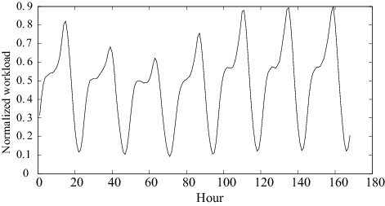
Opportunity

Slide 36
Opportunity
Google: Search queries

Slide 37
Opportunity
Diurnal cycles
Barroso et. al, “The Case for Energy Proportional Computing”, IEEE Computer, 2007
Peng et. al, “Traffic-Driven Power Savings in Operational 3G Cellular Networks”, MOBICOM 2011

Slide 38
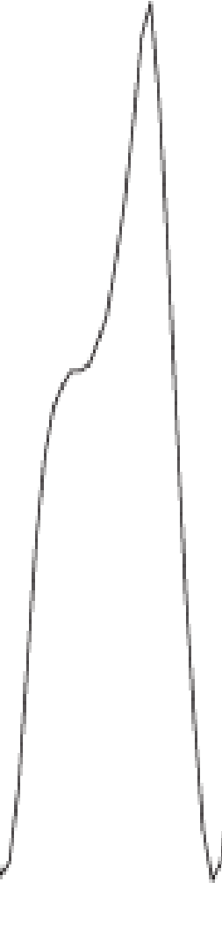
Opportunity
Traffic Volume
Time
Peak and trough are quite pronounced

Slide 39
Opportunity
Network provisioned according to peak
Traffic Volume
Time

Slide 40
Opportunity
Network provisioned according to peak
Google: Enough servers, storage and bw to handle peak
Traffic Volume
Time

Slide 41
Opportunity
Network provisioned according to peak
Google: Enough servers, storage and bw to handle peak
Traffic Volume
Most equipment (nearly) idle
Time

Slide 42
Opportunity
DC Idle power
75%-85% of peak power
Traffic Volume
Power consumption (Watt)
Workload
Time
Source: Emerson, “Energy Logic: Reducing Data Center Power Consumption…”

Slide 43
Opportunity
DC Idle power
75%-85% of peak power
Traffic Volume
Power consumption (Watt)
Opportunity for electricity cost savings
Workload
Time
Source: Emerson, “Energy Logic: Reducing Data Center Power Consumption…”

Slide 44
Key Idea
Deactivate idle equipment
Notes:
Bigger. Photo of a real data center then zoom

Slide 45
Key Idea
Data Center
CA
Notes:
Bigger. Photo of a real data center then zoom

Slide 46
Key Idea
CA: California
Data Center
CA
Notes:
Bigger. Photo of a real data center then zoom

Slide 47
Key Idea
CA: California
NY: New York
TX: Texas
NY
TX
CA
Notes:
Bigger. Photo of a real data center then zoom

Slide 48
Key Idea
CA: California
NY: New York
TX: Texas
Workload
NY
TX
CA
Notes:
Bigger. Photo of a real data center then zoom

Slide 49
Key Idea
CA: California
Deactivate some equipment
NY: New York
TX: Texas
NY
TX
CA
Notes:
Bigger. Photo of a real data center then zoom

Slide 50
Key Idea
CA: California
NY: New York
TX: Texas
Resource pruning cuts electricity cost
NY
TX
CA
Notes:
Bigger. Photo of a real data center then zoom

Slide 51

Key Idea
CA: California
NY: New York
TX: Texas
NY
TX
CA
Notes:
Bigger. Photo of a real data center then zoom

Slide 52
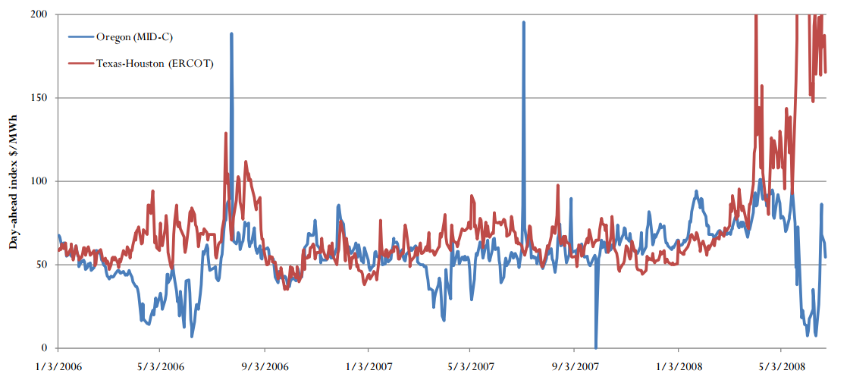
Key Idea
CA: California
NY: New York
TX: Texas
NY
TX
CA
A. Qureshi et. al, “Plugging into energy market diversity”, HOTNETS 2008
Notes:
Bigger. Photo of a real data center then zoom

Slide 53
Key Idea
CA: California
Geographic diversity in electricity prices
NY: New York
TX: Texas
NY
TX
CA
Notes:
Bigger. Photo of a real data center then zoom

Slide 54
Key Idea
CA: California
Geographic diversity in electricity prices
NY: New York
TX: Texas
Temporal diversity in electricity prices
NY
TX
CA
Notes:
Bigger. Photo of a real data center then zoom

Slide 55
Key Idea
CA: California
NY: New York
TX: Texas
122.4
Electricity price
$/MWh
72
52
NY
TX
CA
Notes:
Bigger. Photo of a real data center then zoom

Slide 56
Key Idea
CA: California
NY: New York
TX: Texas
Most expensive
122.4
CA
Electricity price
$/MWh
72
NY
52
TX
Least expensive
Notes:
Bigger. Photo of a real data center then zoom

Slide 57
Key Idea
CA: California
NY: New York
TX: Texas
Move workload from NY to TX
122.4
CA
Electricity price
$/MWh
72
NY
52
TX
Notes:
Bigger. Photo of a real data center then zoom

Slide 58
Key Idea
CA: California
Workload relocation (WR)
NY: New York
TX: Texas
122.4
CA
Electricity price
$/MWh
72
NY
52
TX
Notes:
Bigger. Photo of a real data center then zoom

Slide 59
Key Idea
CA: California
NY: New York
TX: Texas
122.4
CA
Electricity price
$/MWh
72
NY
52
TX
Workload relocation cuts electricity cost further
Notes:
Bigger. Photo of a real data center then zoom

Slide 60
Key Idea
RP to save more
CA: California
NY: New York
TX: Texas
122.4
CA
Electricity price
$/MWh
72
NY
52
TX
Notes:
Bigger. Photo of a real data center then zoom

Slide 61
Key Idea
CA: California
As workload rises…
NY: New York
TX: Texas
122.4
CA
Electricity price
$/MWh
72
NY
52
TX
Notes:
Bigger. Photo of a real data center then zoom

Slide 62
Key Idea
When workload rises even more …
CA: California
NY: New York
TX: Texas
122.4
CA
Electricity price
$/MWh
72
NY
52
TX
Notes:
Bigger. Photo of a real data center then zoom

Slide 63
Key Idea
RP and WR can cut electricity costs
Notes:
Bigger. Photo of a real data center then zoom

Slide 64
Key Idea
RP and WR can cut electricity costs
Ain’t no such thing as a free lunch
Notes:
Bigger. Photo of a real data center then zoom

Slide 65
Transition Costs
Workload relocation overheads
E.g., Cost of data transfers
Expensive inter-data center links

Slide 66
Transition Costs
Workload relocation overheads
E.g., Cost of data transfers
Expensive inter-data center links
Equipment activation and de-activation overheads
E.g., Energy spent while resuming and sleeping

Slide 67
Transition Costs
Workload relocation overheads
E.g., Cost of data transfers
Expensive inter-data center links
Equipment activation and de-activation overheads
E.g., Energy spent while resuming and sleeping
Must consider transition costs while optimizing

Slide 68
Transition Costs
Workload relocation overheads
E.g., Cost of data transfers
Expensive inter-data center links
Equipment activation and de-activation overheads
E.g., Energy spent while resuming and sleeping
Must consider transition costs while optimizing
Relocate Energy Demand to Better Locations (RED-BL)

Slide 69
This Thesis
Towards systematic minimization of network electricity cost
using Workload Relocation (WR) and Resource Pruning (RP)
while considering transition costs
Notes:
Abbreviate. Single thesis statement
This thesis uses (boxes) WR and RP with consideration of relocation and (transition) costs by developing a systematic framework for electricity cost minimization

Slide 70
Contributions
Optimal state trajectory formulation [1]
Considered transition costs [1]
Evaluation of cost savings under various scenarios using real traces [1]
Evaluated impact of prediction accuracy on savings [1]
[1] “RED-BL: Energy Solution for Loading Data Centers”, Infocom 2013 mini-conference

Slide 71
Contributions
Evaluation of RED-BL with:
Partial data center shutdown [2]
Sleep modes [2]
Sliding window re-optimization [2]
Granular deactivation of data center equipment [2]
Showed that RED-BL (for data centers) is the NP-Complete unit commit problem [2]
[2] “RED-BL: Evaluating Dynamic Right Sizing for Data Center Networks”, Elsevier Computer Networks, 2014

Slide 72
Contributions
Application of state trajectory optimization to cellular networks [2, 3]
Showed that RED-BL for cellular networks is NP-Hard [4]
Evaluated RED-BL using traces from a live network [3, 4]
[3] “Electricity Cost Efficient Workload Mapping”, IEEE INFOCOM 2013 Computer Communications Workshop
[4] “Low-Carb: Reducing Energy Consumption in Operational Cellular Networks” IEEE GLOBECOM 2013

Slide 73
Agenda
Background and motivation
Opportunity and key idea
Case studies:
Data centers (e.g., Facebook and Google)
Cellular networks (e.g., Sprint and Verizon)
Conclusions and future work

Slide 74
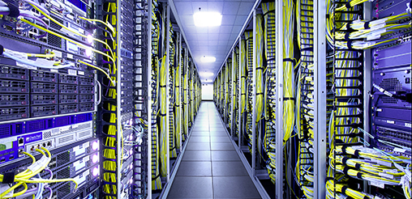
Case Study – I : Background
Source: http://bit.ly/1mrIi7o
Notes:
Photo

Slide 75
Case Study – I : Background
Data center operator
Geographically distributed data centers
Notes:
Photo

Slide 76
Case Study – I : Background
Data center operator
Geographically distributed data centers
Data center equipment
IT Load | Non-IT Load
Servers | Lighting
Storage | Cooling
Network | Power distribution
Notes:
Photo

Slide 77
Case Study – I : Background
Data center operator
Geographically distributed data centers
Data center equipment
Power drawn is affine function of workload
IT Load | Non-IT Load
Servers | Lighting
Storage | Cooling
Network | Power distribution
Notes:
Photo

Slide 78
Case Study – I : Background
Data center operator
Geographically distributed data centers
Data center equipment
Power drawn is affine function of workload
IT Load | Non-IT Load
Servers | Lighting
Storage | Cooling
Network | Power distribution
Let’s recap how we can use WR and RP
Notes:
Photo

Slide 79
Problem Model
Interval - 1
NY
CA
TX
Electricity price driven workload assignment

Slide 80
Problem Model
Interval - 1
NY
CA
TX
Network State

Slide 81
Problem Model
Interval - 1
NY
CA
TX
12
Network State
State Cost
Sum of all data centers’ electricity cost

Slide 82
Problem Model
Interval - 1
Interval - 2
NY
TX
CA
CA
TX
NY
12
10

Slide 83
Problem Model
Interval - 1
Interval - 2
NY
TX
CA
CA
TX
NY
12
10
Data center activation

Slide 84
Problem Model
Data center deactivation
Interval - 1
Interval - 2
NY
TX
CA
CA
TX
NY
12
10
Data center activation

Slide 85
Problem Model
Data center deactivation
Interval - 1
Interval - 2
NY
TX
CA
8
CA
TX
NY
12
10
Transition cost
Data center activation

Slide 86
Problem Model
Interval - 1
Interval - 2
Interval - 3
NY
TX
TX
CA
8
6
CA
NY
TX
NY
CA
12
10
10

Slide 87
Problem Model
Interval - 1
Interval - 2
Interval - 3
NY
TX
TX
CA
8
6
CA
NY
TX
NY
CA
12
10
10
Locally optimal

Slide 88
Problem Model
Interval - 1
Interval - 2
Interval - 3
NY
TX
TX
CA
8
6
CA
NY
TX
NY
CA
12
10
10
Locally optimal
Might not be globally optimal

Slide 89
Problem Model
Interval - 1
Interval - 2
Interval - 3
NY
TX
TX
CA
8
6
CA
NY
TX
NY
CA
12
10
10
An alternative workload mapping

Slide 90
Problem Model
Interval - 1
Interval - 2
Interval - 3
NY
TX
TX
CA
8
6
CA
NY
TX
NY
CA
12
10
10
An alternative workload mapping
NY
CA
TX
14

Slide 91
Problem Model
Interval - 1
Interval - 2
Interval - 3
NY
TX
TX
CA
8
6
CA
NY
TX
NY
CA
12
10
10
State cost locally suboptimal
An alternative workload mapping
NY
CA
TX
14

Slide 92
Problem Model
Interval - 1
Interval - 2
Interval - 3
NY
TX
TX
CA
8
6
CA
NY
TX
NY
CA
12
10
10
State cost locally suboptimal
An alternative workload mapping
NY
TX
CA
CA
TX
NY
14
12

Slide 93
Problem Model
Interval - 1
Interval - 2
Interval - 3
NY
TX
TX
CA
8
6
CA
NY
TX
NY
CA
12
10
10
State cost locally suboptimal
An alternative workload mapping
NY
TX
TX
CA
CA
NY
TX
NY
CA
14
12
12

Slide 94
Problem Model
Interval - 1
Interval - 2
Interval - 3
NY
TX
TX
CA
8
6
CA
NY
TX
NY
CA
12
10
10
An alternative workload mapping
No transition costs
NY
TX
TX
CA
CA
0
NY
TX
NY
CA
14
12
12

Slide 95
Problem Model
Interval - 1
Interval - 2
Interval - 3
NY
TX
TX
CA
8
6
CA
NY
TX
NY
CA
12
10
10
Transition costs lower than local optimal scheme
An alternative workload mapping
NY
TX
TX
CA
4
CA
0
NY
TX
NY
CA
14
12
12

Slide 96
Problem Model
Interval - 1
Interval - 2
Interval - 3
NY
TX
TX
CA
8
6
CA
NY
TX
NY
CA
12
10
10
An alternative workload mapping
Total cost: 42
NY
TX
TX
CA
4
CA
0
NY
TX
NY
CA
14
12
12

Slide 97
Problem Model
Interval - 1
Interval - 2
Interval - 3
NY
TX
TX
CA
8
6
CA
NY
TX
NY
CA
12
10
10
Total cost: 46
An alternative workload mapping
Total cost: 42
NY
TX
TX
CA
4
CA
0
NY
TX
NY
CA
14
12
12

Slide 98
Problem Model
Interval - 1
Interval - 2
Interval - 3
NY
TX
TX
CA
8
6
CA
NY
TX
NY
CA
12
10
10
Optimal State Trajectory Problem
NY
TX
TX
CA
4
CA
0
NY
TX
NY
CA
14
12
12

Slide 99
Problem Model
Interval - 1
Interval - 2
Interval - 3
NY
TX
TX
CA
8
6
CA
NY
TX
NY
CA
12
10
10
Optimal State Trajectory Problem
Relocate Energy Demand to Better Locations (RED-BL)
NY
TX
TX
CA
4
CA
0
NY
TX
NY
CA
14
12
12

Slide 100
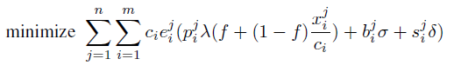
Optimization Formulation
Transition energy
Notes:
Give the objective function and the constraints

Slide 101
Optimization Formulation
State energy
Transition energy
Notes:
Give the objective function and the constraints

Slide 102
Optimization Formulation
Unit price of electricity
State energy
Transition energy
Notes:
Give the objective function and the constraints

Slide 103
Optimization Formulation
Workload
State energy
Transition energy
Notes:
Give the objective function and the constraints

Slide 104
Optimization Formulation
Workload
Data center capacity
State energy
Transition energy
Notes:
Give the objective function and the constraints

Slide 105
Optimization Formulation
Fraction of data center that is active
Workload
Data center capacity
State energy
Transition energy
Notes:
Give the objective function and the constraints

Slide 106
Optimization Formulation
State energy
Transition energy
Notes:
Give the objective function and the constraints

Slide 107
Optimization Formulation
Sum over all data centers
State energy
Transition energy
Notes:
Give the objective function and the constraints

Slide 108
Optimization Formulation
Sum over all intervals
Sum over all data centers
State energy
Transition energy
Subject to several constraints (please see the thesis)
Notes:
Give the objective function and the constraints

Slide 109
Experimental Setup
Workload from 3 popular Facebook apps
Electricity prices from 33 US locations
Simulated a week-long deployment plan
Compared RED-BL against various schemes
Notes:
To evaluate RED-BL for geo-diverse data centers, we performed a simulation study which had the following setup. We used workload from three popular Facebook applications and normalized the cumulative workload. We verified that the characteristics of the cumulative workload resemble that of the workload for thousands of servers in a Google data center. We collected day-ahead electricity prices for 33 locations across the USA and simulated a weeklong deployment plan for the data centers situated at these locations. We compared RED-BL against a number of algorithms.

Slide 110
Comparison Benchmarks

Slide 111
Comparison Benchmarks
1
3
0
2
0
2
UNIFORM: Equally distribute workload
3
1
2
1
3
15
15
20

Slide 112
Comparison Benchmarks
1
3
0
2
0
2
LO: Local Optimal Ignoring Transition Costs
3
1
2
12
1
10
10
3

Slide 113
Comparison Benchmarks
1
3
0
2
0
2
LO: Local Optimal Ignoring Transition Costs
3
1
2
12
1
10
10
3
Theoretical lower bound

Slide 114
Comparison Benchmarks
1
3
0
2
0
2
LO: Local Optimal Ignoring Transition Costs
3
1
2
12
1
10
10
3
Theoretical lower bound
1
3
8
2
6
2
LD: Local Optimal with Deactivation
3
1
2
12
1
10
10
3

Slide 115
Comparison Benchmarks
1
3
0
2
0
2
LO: Local Optimal Ignoring Transition Costs
3
1
2
12
1
10
10
3
Theoretical lower bound
1
3
8
2
6
2
LD: Local Optimal with Deactivation
3
1
2
12
1
10
10
3
1
3
4
2
6
2
LS: Local Optimal with Selection
3
1
2
15
1
10
10
3

Slide 116
Comparison Benchmarks
1
3
0
2
0
2
LO: Local Optimal Ignoring Transition Costs
3
1
2
12
1
10
10
3
Theoretical lower bound
1
3
8
2
6
2
LD: Local Optimal with Deactivation
3
1
2
12
1
10
10
3
Sometimes idling is better
1
3
4
2
6
2
LS: Local Optimal with Selection
3
1
2
15
1
10
10
3

Slide 117
Comparison Benchmarks
1
3
0
2
0
2
LO: Local Optimal Ignoring Transition Costs
3
1
2
12
1
10
10
3
Theoretical lower bound
1
3
8
2
6
2
LD: Local Optimal with Deactivation
3
1
2
12
1
10
10
3
Sometimes idling is better
1
3
4
2
6
2
LS: Local Optimal with Selection
3
1
2
15
1
10
10
3
Best practical variant of local optimal

Slide 118
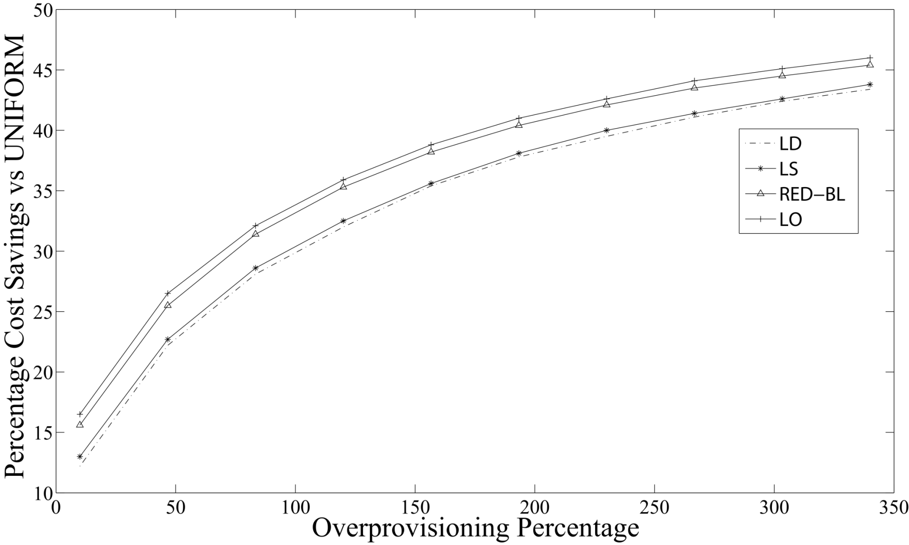
Cost Savings vs Over-provisioning

Slide 119
Cost Savings vs Over-provisioning
RED-BL close to ideal savings

Slide 120
Cost Savings vs Over-provisioning
Falsely predicts high savings

Slide 121
Cost Savings vs Over-provisioning
Actual savings 10.35% lower

Slide 122
Cost Savings vs Over-provisioning
50% over provisioning => 26% Savings

Slide 123
Electricity Cost vs Transition Cost
Notes:
As the magnitude of transition overheads compared to the cost of handling workload increases, we see that the percentage savings in electricity cost decrease for all algorithms. RED-BL achieves close to the ideal lower bound electricity cost savings, whereas the best variants of the greedy algorithm scale worse than RED-BL.

Slide 124
Electricity Cost vs Transition Cost
(De)activation overhead = energy cost
Notes:
As the magnitude of transition overheads compared to the cost of handling workload increases, we see that the percentage savings in electricity cost decrease for all algorithms. RED-BL achieves close to the ideal lower bound electricity cost savings, whereas the best variants of the greedy algorithm scale worse than RED-BL.

Slide 125
Electricity Cost vs Transition Cost
No transition costs
(De)activation overhead = energy cost
Notes:
As the magnitude of transition overheads compared to the cost of handling workload increases, we see that the percentage savings in electricity cost decrease for all algorithms. RED-BL achieves close to the ideal lower bound electricity cost savings, whereas the best variants of the greedy algorithm scale worse than RED-BL.

Slide 126
Electricity Cost vs Transition Cost
Gap widens rapidly
Notes:
As the magnitude of transition overheads compared to the cost of handling workload increases, we see that the percentage savings in electricity cost decrease for all algorithms. RED-BL achieves close to the ideal lower bound electricity cost savings, whereas the best variants of the greedy algorithm scale worse than RED-BL.

Slide 127
Electricity Cost vs Transition Cost
Near optimal savings
Notes:
As the magnitude of transition overheads compared to the cost of handling workload increases, we see that the percentage savings in electricity cost decrease for all algorithms. RED-BL achieves close to the ideal lower bound electricity cost savings, whereas the best variants of the greedy algorithm scale worse than RED-BL.

Slide 128
Granular (De)activation
Cost savings over full data center (de)activation
Notes:
Now, let’s see how RED-BL energy savings would improve if we allowed independent (de)activation of fixed size fractions of a data center. The extreme right handside of this graph represents the case where you can only (de)activate an entire data center at a time. This is 0% better than the standard “all or nothing” RED-BL, because it is the same thing. If we were able to (de)activate half a data center at a time, we could do about 2.5% better than standard RED-BL. If we were able to independently (de)activate 10% of a data center at a time, we could do 5% better than standard RED-BL. So, there is opportunity for greater savings with granular (de)activation and it has a linear trend.

Slide 129
Granular (De)activation
Can only (de)activate entire data center
Can (de)activate half a data center
Notes:
Now, let’s see how RED-BL energy savings would improve if we allowed independent (de)activation of fixed size fractions of a data center. The extreme right handside of this graph represents the case where you can only (de)activate an entire data center at a time. This is 0% better than the standard “all or nothing” RED-BL, because it is the same thing. If we were able to (de)activate half a data center at a time, we could do about 2.5% better than standard RED-BL. If we were able to independently (de)activate 10% of a data center at a time, we could do 5% better than standard RED-BL. So, there is opportunity for greater savings with granular (de)activation and it has a linear trend.

Slide 130
Granular (De)activation
Opportunity for greater savings
Notes:
Now, let’s see how RED-BL energy savings would improve if we allowed independent (de)activation of fixed size fractions of a data center. The extreme right handside of this graph represents the case where you can only (de)activate an entire data center at a time. This is 0% better than the standard “all or nothing” RED-BL, because it is the same thing. If we were able to (de)activate half a data center at a time, we could do about 2.5% better than standard RED-BL. If we were able to independently (de)activate 10% of a data center at a time, we could do 5% better than standard RED-BL. So, there is opportunity for greater savings with granular (de)activation and it has a linear trend.

Slide 131
DVFS Instead of Deactivation
Notes:
If, instead of shutting down an entire data center, we switch the servers into lower-power mode using DVFS techniques, the power savings might reduce, but the scheme would be more agile to workload variations. Here, we see that the power consumption drops linear as the power consumption is lowered with DVFS. If the server power consumption drops to 10% of the peak, the data center power consumption would be reduced by about 70%. Another data point is that if we put all “idle” servers at 50% power consumption, we achieve about 20% power reduction.

Slide 132
Reserve Margin
Notes:
To be prepared for some stray workload at data centers which we planned to deactivate, we’ll keep some servers on as reserve. As we increase the amount of serving capacity in reserve mode, the difference in power consumption will increase compared to the scenario where we did not keep any reserve capacity.
Exactly how much “stray” traffic we receive can’t be predicted. In this chart, the lower line shows the situation where we don’t receive any stray traffic at all. The power consumption in that case is purely due to servers idling. The upper line represents the situation where we need all the reserve capacity for handling stray traffic. The actual situation may be somewhere in between.

Slide 133
Summary – Case Study I
Significant cost savings are possible using RED-BL

Slide 134
Summary – Case Study I
Significant cost savings are possible using RED-BL
Finer granularity of resource (de)activation increases savings

Slide 135
Summary – Case Study I
Significant cost savings are possible using RED-BL
Finer granularity of resource (de)activation increases savings
Low-power mode instead of shutdown also helps considerably

Slide 136
Summary – Case Study I
Significant cost savings are possible using RED-BL
Finer granularity of resource (de)activation increases savings
Low-power mode instead of shutdown also helps considerably
Cost savings decrease sharply with reserve margin

Slide 137
Summary – Case Study I
Significant cost savings are possible using RED-BL
Finer granularity of resource (de)activation increases savings
Low-power mode instead of shutdown also helps considerably
Cost savings decrease sharply with reserve margin
Can we apply this optimization “machinery” to other networks?

Slide 138
Agenda
Background and motivation
Opportunity and key idea
Case studies:
Data centers (e.g., Facebook and Google)
Cellular networks (e.g., Sprint and Verizon)
Conclusions and future work

Slide 139

Case Study II Cellular Networks
Notes:
Give the motivating example to show that WR and RP can be used in cellular networks as well.

Slide 140
Case Study II Cellular Networks
Notes:
Give the motivating example to show that WR and RP can be used in cellular networks as well.

Slide 141
Case Study II Cellular Networks
Notes:
Give the motivating example to show that WR and RP can be used in cellular networks as well.

Slide 142
Case Study II Cellular Networks
Notes:
Give the motivating example to show that WR and RP can be used in cellular networks as well.

Slide 143
Case Study II Cellular Networks
BSC
Notes:
Give the motivating example to show that WR and RP can be used in cellular networks as well.

Slide 144
Case Study II Cellular Networks
BSC
BSC
Notes:
Give the motivating example to show that WR and RP can be used in cellular networks as well.

Slide 145
Case Study II Cellular Networks
BSC
MSC
BSC
Notes:
Give the motivating example to show that WR and RP can be used in cellular networks as well.

Slide 146
Case Study II Cellular Networks
15%-80% of total power consumption
BSC
MSC
BSC
Notes:
Give the motivating example to show that WR and RP can be used in cellular networks as well.

Slide 147
Case Study II Cellular Networks
TRXs
Power amplifiers
Air conditioning
Notes:
Give the motivating example to show that WR and RP can be used in cellular networks as well.

Slide 148
Resource Pruning
BTS Power Consumption (kW)
δ
t_{max}
Call volume

Slide 149
Resource Pruning
BTS Power Consumption (kW)
Workload capacity
δ
t_{max}
Call volume

Slide 150
Resource Pruning
P_{max}
BTS Power Consumption (kW)
Workload capacity
δ
t_{max}
Call volume

Slide 151
Resource Pruning
P_{max}
P_{min}
BTS Power Consumption (kW)
Workload capacity
δ
t_{max}
Call volume

Slide 152
Resource Pruning
P_{max}
P_{min}
Low call volume => Deactivate some TRXs
BTS Power Consumption (kW)
Workload capacity
δ
t_{max}
Call volume

Slide 153
Resource Pruning
P_{max}
P_{min}
BTS Power Consumption (kW)
Power saving threshold (δ)
Workload capacity
δ
t_{max}
Call volume

Slide 154
Resource Pruning
No. of calls ≤ δ
P_{max}
P_{min}
BTS Power Consumption (kW)
Power saving threshold (δ)
Workload capacity
δ
t_{max}
Call volume

Slide 155
Resource Pruning
P_{max}
P_{min}
BTS Power Consumption (kW)
Workload capacity
δ
t_{max}
Call volume

Slide 156
Does workload relocation help?

Slide 157
Does workload relocation help?

Slide 158
Does workload relocation help?
Assume that power saving is enabled if upto two calls are being served

Slide 159
Does workload relocation help?
Power saving
Assume that power saving is enabled if upto two calls are being served

Slide 160
Does workload relocation help?
Power saving
Power saving
Assume that power saving is enabled if upto two calls are being served

Slide 161
Does workload relocation help?
Power saving
Power saving
Handing off some calls may enable greater power savings

Slide 162
Is Workload Relocation Possible?

Slide 163
Drawing Parallels With Case Study I
Parameter | Cellular network | Data centers
Notes:
Identify the similarities and differences between the two networks and observe how abstractions can be made.

Slide 164
Drawing Parallels With Case Study I
Parameter | Cellular network | Data centers
Network resource
Notes:
Identify the similarities and differences between the two networks and observe how abstractions can be made.

Slide 165
Drawing Parallels With Case Study I
Parameter | Cellular network | Data centers
Network resource
Servers
Notes:
Identify the similarities and differences between the two networks and observe how abstractions can be made.

Slide 166
Drawing Parallels With Case Study I
Parameter | Cellular network | Data centers
Network resource
TRX
Servers
Notes:
Identify the similarities and differences between the two networks and observe how abstractions can be made.

Slide 167
Drawing Parallels With Case Study I
Parameter | Cellular network | Data centers
Network resource
TRX
Servers
Workload relocation
Notes:
Identify the similarities and differences between the two networks and observe how abstractions can be made.

Slide 168
Drawing Parallels With Case Study I
Parameter | Cellular network | Data centers
Network resource
TRX
Servers
Workload relocation
Client redirect
Notes:
Identify the similarities and differences between the two networks and observe how abstractions can be made.

Slide 169
Drawing Parallels With Case Study I
Parameter | Cellular network | Data centers
Network resource
TRX
Servers
Workload relocation
Call hand off
Client redirect
Notes:
Identify the similarities and differences between the two networks and observe how abstractions can be made.

Slide 170
Drawing Parallels With Case Study I
Parameter | Cellular network | Data centers
Network resource
TRX
Servers
Workload relocation
Call hand off
Client redirect
Resource pruning
Notes:
Identify the similarities and differences between the two networks and observe how abstractions can be made.

Slide 171
Drawing Parallels With Case Study I
Parameter | Cellular network | Data centers
Network resource
TRX
Servers
Workload relocation
Call hand off
Client redirect
Resource pruning
Server shutdown / idle / hibernate
Notes:
Identify the similarities and differences between the two networks and observe how abstractions can be made.

Slide 172
Drawing Parallels With Case Study I
Parameter | Cellular network | Data centers
Network resource
TRX
Servers
Workload relocation
Call hand off
Client redirect
Resource pruning
Server shutdown / idle / hibernate
BTS Power Saving
Notes:
Identify the similarities and differences between the two networks and observe how abstractions can be made.

Slide 173
Drawing Parallels With Case Study I
Parameter | Cellular network | Data centers
Network resource
TRX
Servers
Workload relocation
Call hand off
Client redirect
Resource pruning
Server shutdown / idle / hibernate
BTS Power Saving
Transition costs
Notes:
Identify the similarities and differences between the two networks and observe how abstractions can be made.

Slide 174
Drawing Parallels With Case Study I
Parameter | Cellular network | Data centers
Network resource
TRX
Servers
Workload relocation
Call hand off
Client redirect
Resource pruning
Server shutdown / idle / hibernate
BTS Power Saving
(De)activation overheads
Transition costs
Notes:
Identify the similarities and differences between the two networks and observe how abstractions can be made.

Slide 175
Drawing Parallels With Case Study I
Parameter | Cellular network | Data centers
Network resource
TRX
Servers
Workload relocation
Call hand off
Client redirect
Resource pruning
Server shutdown / idle / hibernate
BTS Power Saving
(De)activation overheads
Transition costs
Negligible
Notes:
Identify the similarities and differences between the two networks and observe how abstractions can be made.

Slide 176
Optimization Formulation

Slide 177
Optimization Formulation

Slide 178
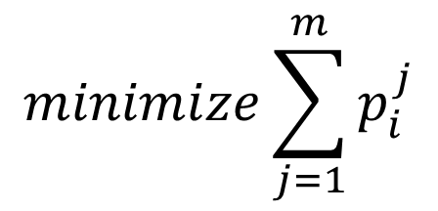
Optimization Formulation
$$minimize\sum_{j=1}^{m}{p_{i}^{j}}$$
For every interval, minimize # TRXs

Slide 179

Optimization Formulation
$$minimize\sum_{j=1}^{m}{p_{i}^{j}}$$
Seemingly simple formulation

Slide 180
Optimization Formulation
$$minimize\sum_{j=1}^{m}{p_{i}^{j}}$$
Seemingly simple formulation
NP-Hard

Slide 181
Complexity 1/2
(δ + 1)th call incurs a sudden jump in power
Other calls bring a small increase in power (ε)
BTS Power Consumption (kW)
δ
t_{max}
Call volume

Slide 182
Complexity 1/2
(δ + 1)th call incurs a sudden jump in power
Other calls bring a small increase in power (ε)
Set δ = 0
BTS Power Consumption (kW)
δ
t_{max}
Call volume

Slide 183
Complexity 1/2
(δ + 1)th call incurs a sudden jump in power
Other calls bring a small increase in power (ε)
Set δ = 0
BTS Power Consumption (kW)
δ
t_{max}
Call volume

Slide 184
Complexity 1/2
(δ + 1)th call incurs a sudden jump in power
Other calls bring a small increase in power (ε)
Set δ = 0
BTS Power Consumption (kW)
δ
t_{max}
Call volume

Slide 185
Complexity 1/2
Set δ = 0
BTS Power Consumption (kW)
At every BTS
First call incurs a sudden jump in power (γ)
δ
t_{max}
Call volume

Slide 186
Complexity 1/2
BTS Cost:
0 calls: 0
n calls: γ + nε
Set δ = 0
Optimal solution will use fewest possible BTSs
BTS Power Consumption (kW)
At every BTS
First call incurs a sudden jump in power (γ)
δ
t_{max}
Call volume

Slide 187
Complexity 1/2
Set δ = 0
BTS Power Consumption (kW)
δ
t_{max}
Call volume
Set K
(BTSs)

Slide 188
Complexity 1/2
Set δ = 0
BTS Power Consumption (kW)
δ
t_{max}
Call volume
Set J
(Calls)
Set K
(BTSs)

Slide 189
Complexity 1/2
RED-BL: Minimum cardinality subset that covers J
Set δ = 0
BTS Power Consumption (kW)
δ
t_{max}
Call volume
Set J
(Calls)
Set K
(BTSs)

Slide 190
Complexity 1/2
Call this graph problem:
Modified MDS
Set δ = 0
BTS Power Consumption (kW)
δ
t_{max}
Call volume
Set J
(Calls)
Set K
(BTSs)

Slide 191
Complexity 2/2
A
B
C
D
Minimum Dominating Set (MDS)

Slide 192
Complexity 2/2
A
B
C
D
Minimum Dominating Set (MDS)
Smallest subset V’ of vertices V such that every other vertex is adjacent to at least one vertex in V’

Slide 193
Complexity 2/2
A
B
C
D
Minimum Dominating Set (MDS)

Slide 194
Complexity 2/2
A
B
C
D
Minimum Dominating Set (MDS)

Slide 195
Complexity 2/2
Make two copies of vertices
A
B
C
D
Minimum Dominating Set (MDS)

Slide 196
Complexity 2/2
Make two copies of vertices
A
A
B
B
C
C
D
D
Set K
(BTSs)
Minimum Dominating Set (MDS)

Slide 197
Complexity 2/2
Make two copies of vertices
A
A’
A
B
B’
B
C
C
C’
D
D’
D
Set K
(BTSs)
Set J
(Calls)
Minimum Dominating Set (MDS)

Slide 198
Complexity 2/2
Make two copies of vertices
Place edges between each vertex and its copy
A
A’
A
B
B’
B
C
C
C’
D
D’
D
Set K
(BTSs)
Set J
(Calls)
Minimum Dominating Set (MDS)

Slide 199
Complexity 2/2
Make two copies of vertices
Place edges between each vertex and its copy
A
A’
A
B
B’
B
C
C
C’
D
D’
D
Set K
(BTSs)
Set J
(Calls)
Minimum Dominating Set (MDS)

Slide 200
Complexity 2/2
Make two copies of vertices
Place edges between each vertex and its copy
Replicate other edges in original graph
A
A’
A
B
B’
B
C
C
C’
D
D’
D
Set K
(BTSs)
Set J
(Calls)
Minimum Dominating Set (MDS)

Slide 201
Complexity 2/2
Make two copies of vertices
Place edges between each vertex and its copy
Replicate other edges in original graph
A
A’
A
B
B’
B
C
C
C’
D
D’
D
Set K
(BTSs)
Set J
(Calls)
Minimum Dominating Set (MDS)

Slide 202
Complexity 2/2
Make two copies of vertices
Place edges between each vertex and its copy
Replicate other edges in original graph
A
A’
A
B
B’
B
C
C
C’
D
D’
D
Set K
(BTSs)
Set J
(Calls)
Minimum Dominating Set (MDS)

Slide 203
Complexity 2/2
Make two copies of vertices
Place edges between each vertex and its copy
Replicate other edges in original graph
A
A’
A
B
B’
B
C
C
C’
D
D’
D
Set K
(BTSs)
Set J
(Calls)
Minimum Dominating Set (MDS)

Slide 204
Complexity 2/2
Make two copies of vertices
Place edges between each vertex and its copy
Replicate other edges in original graph
Solve Modified MDS on new graph
A
A’
A
B
B’
B
C
C
C’
D
D’
D
Set K
(BTSs)
Set J
(Calls)
Minimum Dominating Set (MDS)

Slide 205
Complexity 2/2
Make two copies of vertices
Place edges between each vertex and its copy
Replicate other edges in original graph
Solve Modified MDS on new graph
A
A’
A
B
B’
B
C
C
C’
D
D’
D
Set K
(BTSs)
Set J
(Calls)
Minimum Dominating Set (MDS)

Slide 206
Complexity 2/2
Make two copies of vertices
Place edges between each vertex and its copy
Replicate other edges in original graph
Solve Modified MDS on new graph
A
A’
A
B
B’
MDS Solved!
B
C
C
C’
D
D’
D
Set K
(BTSs)
Set J
(Calls)
Minimum Dominating Set (MDS)

Slide 207
Complexity 2/2
A
A’
A
B
B’
MDS Solved!
B
C
C
C’
D
D’
D
Set K
(BTSs)
Set J
(Calls)
Minimum Dominating Set (MDS)

Slide 208
Complexity 2/2
RED-BL for cellular
A
A’
A
B
B’
MDS Solved!
B
C
C
C’
D
D’
D
Set K
(BTSs)
Set J
(Calls)
Minimum Dominating Set (MDS)

Slide 209
Complexity 2/2
RED-BL for cellular
solves
Modified MDS
A
A’
A
B
B’
MDS Solved!
B
C
C
C’
D
D’
D
Set K
(BTSs)
Set J
(Calls)
Minimum Dominating Set (MDS)

Slide 210
Complexity 2/2
RED-BL for cellular
solves
Modified MDS
solves
MDS
A
A’
A
B
B’
MDS Solved!
B
C
C
C’
D
D’
D
Set K
(BTSs)
Set J
(Calls)
Minimum Dominating Set (MDS)

Slide 211
Complexity 2/2
RED-BL for cellular
solves
Modified MDS
solves
MDS
A
A’
NP-Hard
A
B
B’
MDS Solved!
B
C
C
C’
D
D’
D
Set K
(BTSs)
Set J
(Calls)
Minimum Dominating Set (MDS)

Slide 212
Complexity 2/2
RED-BL for cellular
solves
Modified MDS
solves
MDS
A
A’
NP-Hard
NP-Hard
A
B
B’
MDS Solved!
B
C
C
C’
D
D’
D
Set K
(BTSs)
Set J
(Calls)
Minimum Dominating Set (MDS)

Slide 213
Experimental Setup

Slide 214
Experimental Setup
Call volume traces for 2 days at 26 urban BTSs

Slide 215
Experimental Setup
Call volume traces for 2 days at 26 urban BTSs
Trace driven simulation:
Periodically obtain optimal call placement
Place BTSs with low-traffic in power-saving mode

Slide 216
BTS Power Consumption Models
Parameter | Value
 | Model 1 | Model 2 | Model 3
Idle Power (W) | 1425 | 2401.8 | 2341.5
Peak Power (W) | 1500 | 3887.5 | 2973.9
Power Saving per TRX (W) | 20 | 50 | 100

Slide 217
Results: Power-Saving Feature Only
Energy savings | Model 1 | Model 2 | Model 3
Percentage | 4.73% | 5.43% | 12.89%
Daily energy savings (kWh) | 43.28 | 109.68 | 217.12
Country-wide daily savings -31000 sites (MWh) | 51.6 | 130.77 | 258.87

Slide 218
Results: Power-Saving Feature Only
Energy savings | Model 1 | Model 2 | Model 3
Percentage | 4.73% | 5.43% | 12.89%
Daily energy savings (kWh) | 43.28 | 109.68 | 217.12
Country-wide daily savings -31000 sites (MWh) | 51.6 | 130.77 | 258.87

Slide 219
Results: Power-Saving + Handoff Absolute Energy Savings (%)

Slide 220
Results: Power-Saving + Handoff Absolute Energy Savings (kWh)

Slide 221
Effect of Granular Deactivation
Granularity | Model 1 | Model 2 | Model 3
2-state | 5.38% | 6.29% | 14.94%
3-state | 6.81% | 7.73% | 18.62%
6-state | 8.70% | 9.65% | 23.37%

Slide 222
Effect of Granular Deactivation
Granularity | Model 1 | Model 2 | Model 3
2-state | 5.38% | 6.29% | 14.94%
3-state | 6.81% | 7.73% | 18.62%
6-state | 8.70% | 9.65% | 23.37%
Savings increase with finer granularity

Slide 223
Effect of Late Deactivation

Slide 224
A Randomized Algorithm

Slide 225
A Randomized Algorithm
While there are BTSs in high-power mode

Slide 226
A Randomized Algorithm
While there are BTSs in high-power mode
Pick a random BTS

Slide 227
A Randomized Algorithm
Pick this
While there are BTSs in high-power mode
Pick a random BTS

Slide 228
A Randomized Algorithm
While there are BTSs in high-power mode
Pick a random BTS
For each call being handled by this BTS

Slide 229
A Randomized Algorithm
While there are BTSs in high-power mode
Pick a random BTS
For each call being handled by this BTS
Hand-over to a candidate BTS in low-power mode

Slide 230
A Randomized Algorithm
Nope
While there are BTSs in high-power mode
Pick a random BTS
For each call being handled by this BTS
Hand-over to a candidate BTS in low-power mode

Slide 231
A Randomized Algorithm
While there are BTSs in high-power mode
Pick a random BTS
For each call being handled by this BTS
Hand-over to a candidate BTS in low-power mode
Nope

Slide 232
A Randomized Algorithm
While there are BTSs in high-power mode
Pick a random BTS
For each call being handled by this BTS
Hand-over to a candidate BTS in low-power mode
Yup!

Slide 233
A Randomized Algorithm
While there are BTSs in high-power mode
Pick a random BTS
For each call being handled by this BTS
Hand-over to a candidate BTS in low-power mode
Yup!

Slide 234
A Randomized Algorithm
While there are BTSs in high-power mode
Pick a random BTS
For each call being handled by this BTS
Hand-over to a candidate BTS in low-power mode
Power saving
Power saving

Slide 235
Performance of Heuristic Algorithm

Slide 236
Case Study II - Summary
Traffic has limited geo-flexibility compared to data centers
No geo-diversity in electricity prices
Activation of power savings feature in hardware helps
RED-BL achieves greater savings even for relatively conservative settings

Slide 237
Agenda
Background and motivation
Opportunity and key idea
Case studies:
Data centers (e.g., Facebook and Google)
Cellular networks (e.g., Sprint and Verizon)
Conclusions and future work

Slide 238
Conclusions
Opportunities for electricity cost savings using:
Workload relocation
Resource pruning
WR and RP are applicable to:
Data centers
Cellular networks
Others (need to explore)

Slide 239
Conclusions
Modeled electricity cost minimization as an optimal state trajectory problem
Showed the problem to be NP-Hard in the two case studies
Studied the sensitivity of the problem to various parameters

Slide 240
Conclusions
Data centers and cellular networks:
Sets of geo-diverse resources
Contrasts:
Availability of geo-diversity in electricity prices
Geo-flexibility in traffic
Magnitude of transition costs

Slide 241
Future Work
Factor in other forms of transition costs:
Cost of change in latency
Cost of replication
Cost of increase in call blocking probability
Implementation on software BTS
Incorporation into an OA&M framework
Adaptation to recent generations of cellular networks
Consider expensive diesel-generated power in cellular BTSs

Slide 242
Questions and Answers
If you can read this
Murphy’s law was violated

Slide 243
List of Papers
Published:
A simulation study of GELS for Ethernet over WAN, GLOBECOM 2007
RED-BL: Energy solution for loading data centers, INFOCOM Mini-Conference, 2012
Electricity cost efficient workload mapping, INFOCOM Computer Communications Workshop, 2013
Low-Carb: Reducing energy consumption in operational cellular networks, GLOBECOM 2013
RED-BL: Evaluating dynamic right sizing for data centers, Computer Networks, vol. 72, 2014
Submitted:
Low-Carb: A practical scheme for improving energy efficiency in cellular networks

Slide 244
Questions 1
Why not have one data center at the cheapest locations?
There is no single cheapest location
Diversity for:
Disaster
Latency

Slide 245
Question 2
Why can’t DVFS be used?
It can certainly be used
It does not achieve fine grained energy proportionality
Granularity of VF scaling is coarse
Other components are also energy proportional

